Slide 1
Working with Standard Actions

Slide 2
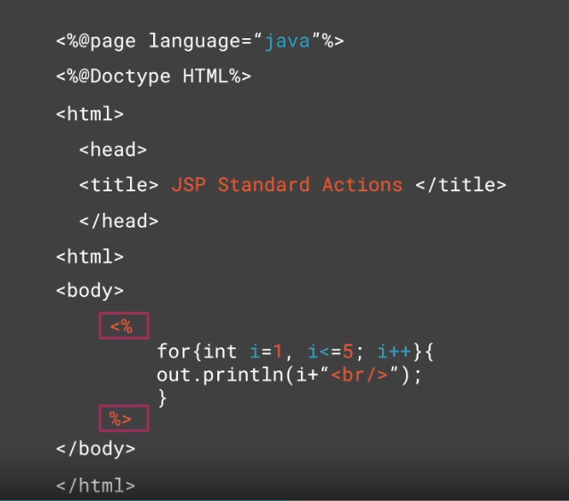

Slide 3
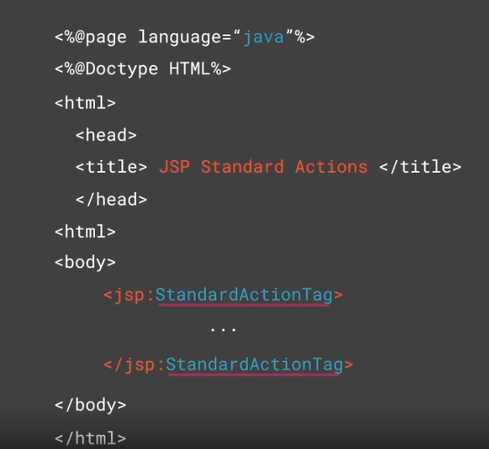

Slide 4
<jsp:include>
<jsp:forward>
<jsp:param>
<jsp:useBean>
<jsp:setProperty>
<jsp:getProperty>
<jsp:plugins>
<jsp:fallback>
<jsp:attribute>
<jsp:body>
<jsp:invoke>
<jsp:element>
<jsp:text>
JSP Standard
Actions

Slide 7
<jsp:include>

Slide 8
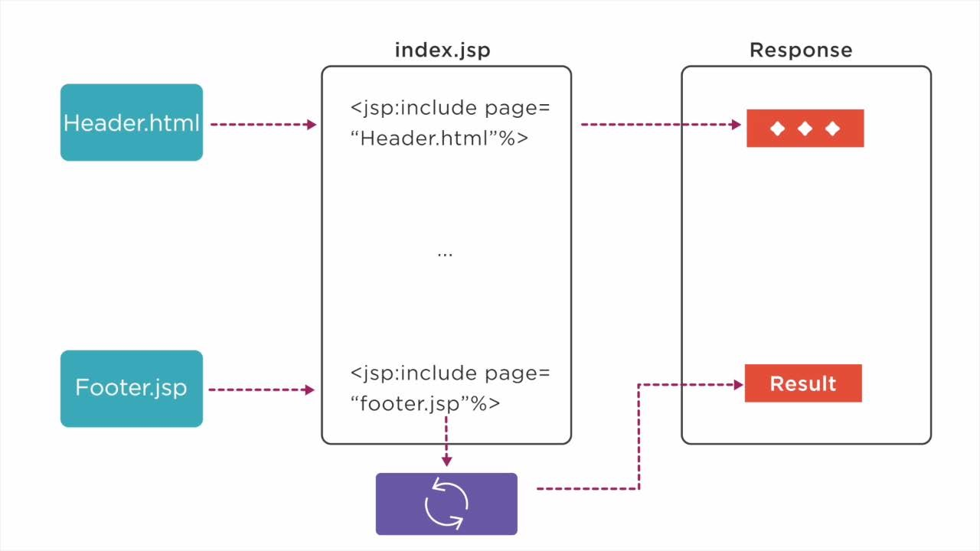
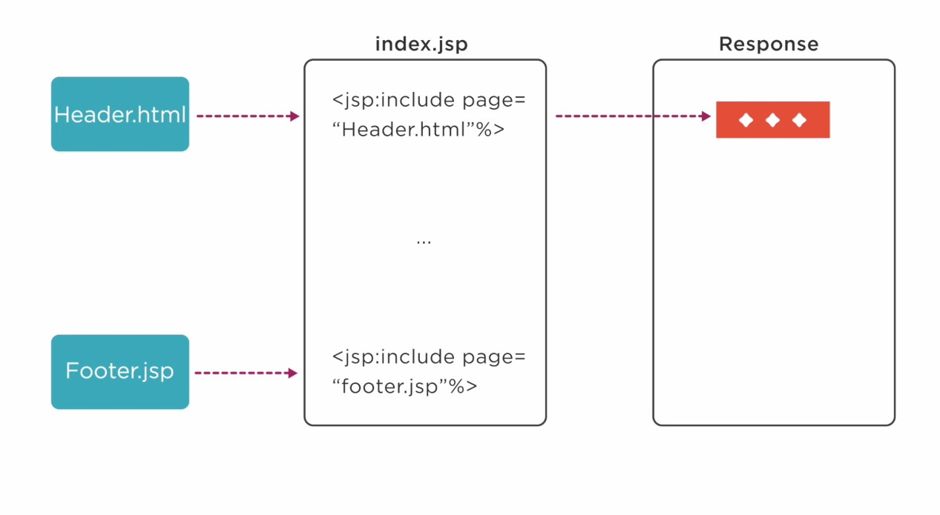

Slide 9
<jsp:include page="url flush=“true| false"/>
Syntax
<jsp:include>

Slide 10
main.jsp
date.jsp
<%page language="java"%>
<html>
<head>
<title>The include Action Example</title>
</head>
<body>
<center>
<h2>The include Action Example</h2>
<jsp:include page="date.jsp" flush="true"/>
</center>
<p>Copyright&copy;LearnToday</p>
</body>
</html>
<p>
Date:<%=(new java.util.Date()).toLocaleString()%>
</p>

Slide 12
? What is the difference between include action and include directive

Slide 13
Include directive (<%@include%>)
Copies the code from one page to another page
Copies the code during the
translation time
Generates only one Servlet
Static Binding
Include action (jsp:include)
Copies the results from one page to another page
Copies the output during the runtime
Generates two Servlets Performs Dynamic Binding

Slide 14
<jsp:forward>

Slide 15
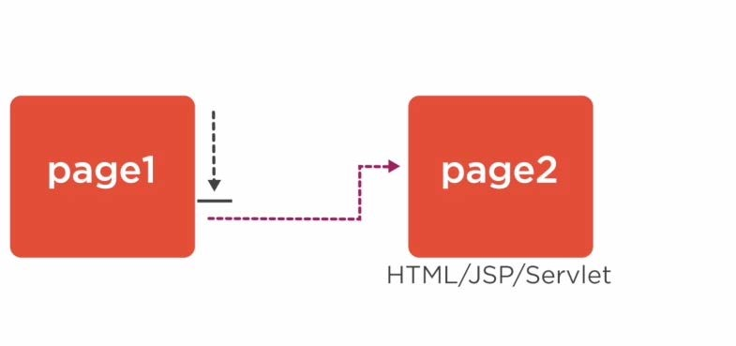

<jsp:forward=getRequestDispatcher().forward()
JSP page must be buffered to use a <jsp:forward > tag

Slide 16
<jsp:forward page="url"/>
Syntax
<jsp:forward> action tag

Slide 17
date.jsp
main.jsp
<%page language="java"%>
<html>
<head>
<title>The forward Action Example</title>
</head>
<body>
<center>
<h2>The forward Action Example</h2>
<jsp:forward page="date.jsp" flush="true"/>
</center>
<p>Copyright&copy;LearnToday</p>
</body>
</html>
<p>
Date:<%=(new java.util.Date()).toLocaleString()%>
</p>

Slide 20
Sendredirect
<jsp:forward>
Direct communication between source and destination pages
Uses same request and response
object
Source and destination pages should belong to same application
Indirect communication between source and destination page
Uses separate request and response object
Can be in one same application/different application/same server/different server

Slide 21
<jsp:param>

Slide 22
<jsp:param name="..." value="..."/>
Syntax
<jsp:param>
Used as a sub-tag for include,forward or plugin action

Slide 23
main.jsp
course.jsp
<%page language="java"%>
<html>
<head>
<title>The include Action Example</title>
</head>
<body>
<h2>Course Details:</h2>
<p>Course Name:<%= request.getParameter
(“courseName")%></p>
<p>Trainer:<%= request.getParameter ("trainer")%></p>
</body>
</html>
<%page language="java"%>
<html>
<head>
<title>The include Action Example</title>
</head>
<body>
<jsp:forward page=“course.jsp">
<jsp:param name="courseName" value=“JAVA">
<jsp:param name="trainer "value="Steve Samuels">
</ jsp forward>
</body>
</html>

Slide 25
<jsp:useBean>

Slide 26
public class JavaBeanName implements Serializable
{
public class JavaBeanName(){} private String propertyName;
public void setPropertyName(String value){this.propertyName=value;} public void getPropertyName(){return this.propertyname;}
}
What is Java Bean?

Slide 27
<jsp:useBean>
useBean action is a way for declaring and initializing the actual java bean component object

Slide 28
<jsp:useBean attributes/>
Syntax
<jsp:useBean>

Slide 29
id
class scope
page request session application
type beanName
Attributes of
<jsp:useBean>

Slide 31
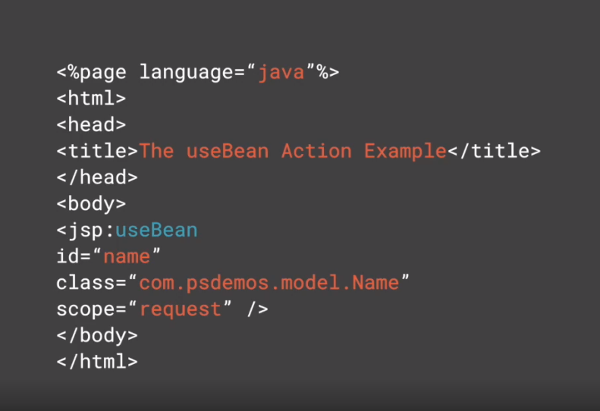

Slide 32
<jsp:setProperty>

Slide 35
<jsp:setProperty name= "
property="propertyName|*" value="..."param="..."/>
Syntax
<jsp:setProperty>

Slide 36
setName.jsp
main.jsp
<form name="f1" action="setName.jsp">
<p>First Name:<input type="text" name="firstName" id="firstName"/></p>
<p>LastName:<input type="text“ name="lastName"id="lastName"/>
</p>
<p><input type="submit"value="Submit"/>
</p>
</form>
<jsp:useBean id="nameBean" class="com.psdemos.model.Name" scope="request">
<jsp:setProperty name="nameBean“ property="firstName“ params="firstName"/>
<jsp:setPropertyname="nameBean” property="lastName” params="lastName"/>
</jsp:useBean>

Slide 37
setName.jsp
main.jsp
<form name="f1" action="setName.jsp">
<p>First Name:<input type="text" name="firstName" id="lastName"/></p>
<p>lastName:<input type="text“ name="lastName"id="lastName"/>
</p>
<p><input type="submit"value="Submit"/>
</p>
</form>
<jsp:useBean id="nameBean" class="com.psdemos.model.Name" scope="request">
<jsp:useBean id="nameBean“ property="*"/>
</jsp:useBean>

Slide 38
<jsp:getProperty>

Slide 39
<jsp:getProperty name="..." property="..."/>
Syntax
<jsp:getProperty>

Slide 40
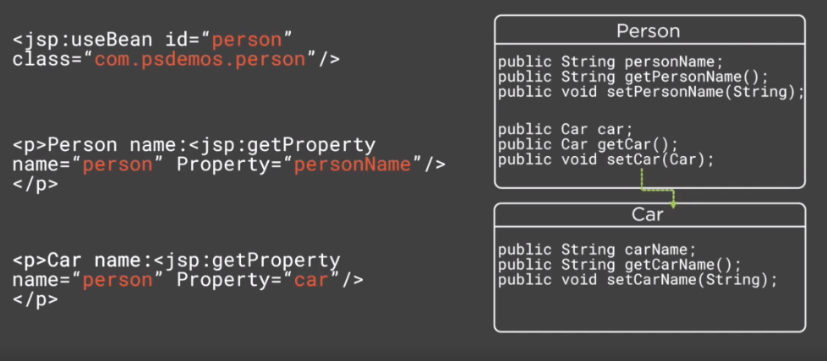

Slide 41
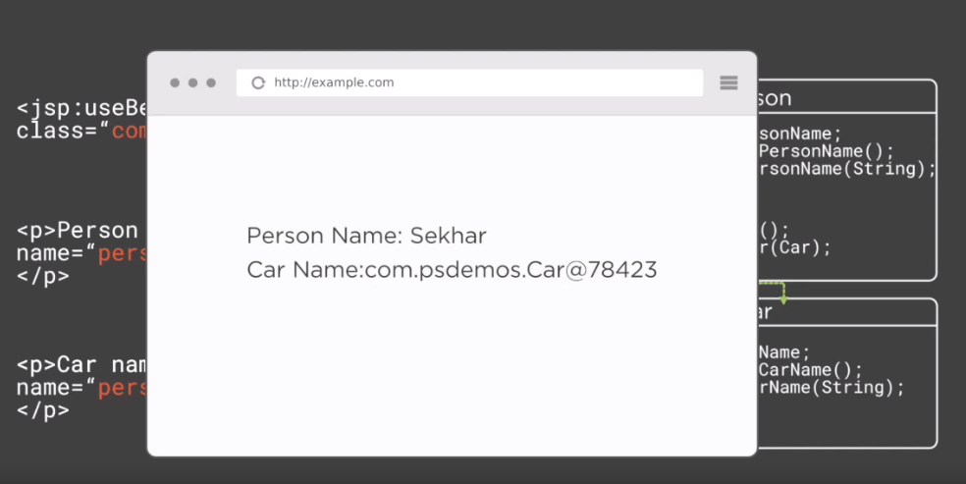

Slide 42
setName.jsp
<jsp:useBean id="nameBean" class="com.psdemos.model.Name" scope="request">
<jsp:useBean id="nameBean" property="*"/>
</jsp:useBean>
<p>First Name : <jsp:getProperty name="nameBean"property="firstName"/></p>
<p>Last Name :<jsp:getProperty name="nameBean"property="lastName”/></p>
<p><a href="getName.jsp">Read Value</a></p>

Slide 43
getName.jsp
<jsp:useBean id="nameBean" class="com.psdemos.model.Name" scope="request">
<p>First Name:<jsp:getProperty name="nameBean" property="firstName"/></p>
<p>Last Name :<jsp:getProperty name="nameBean" property="lastName"/><p>
</jsp:useBean>
<hr/>
<p>First Name :<jsp:getProperty name="nameBean"property="firstName"/></p>
<p>Last Name :<jsp:getProperty name="nameBean"property="lastName"/></p>

Slide 44
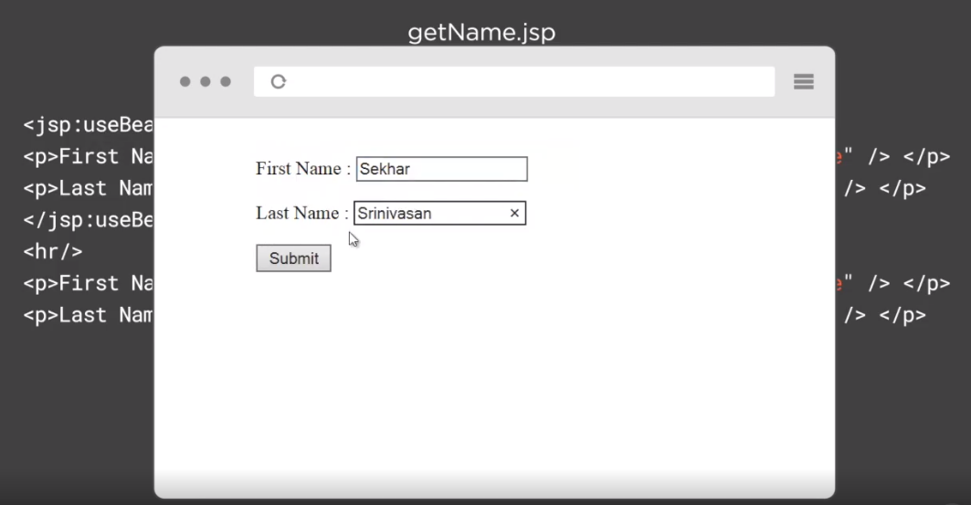

Slide 45
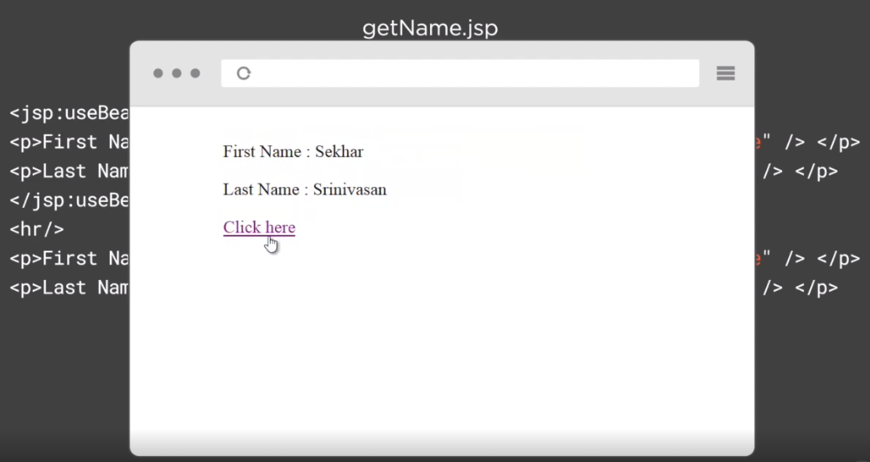

Slide 46
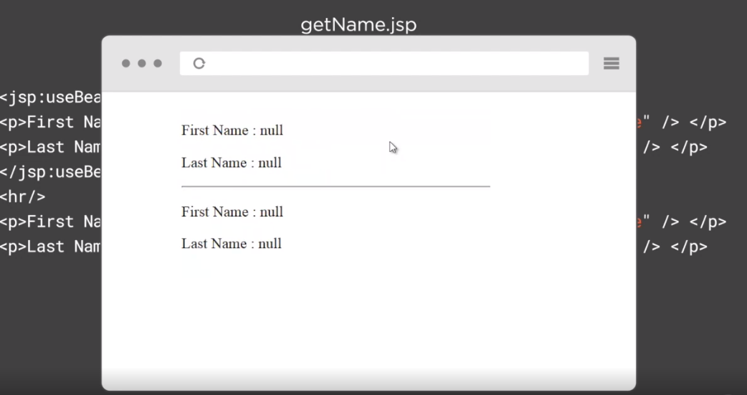

Slide 47
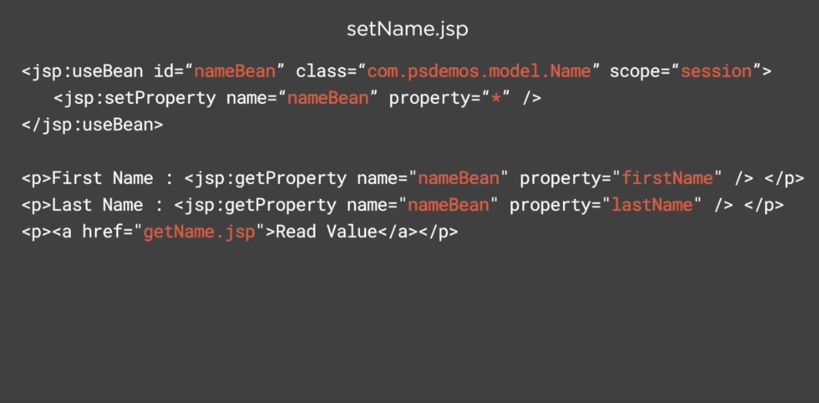

Slide 48
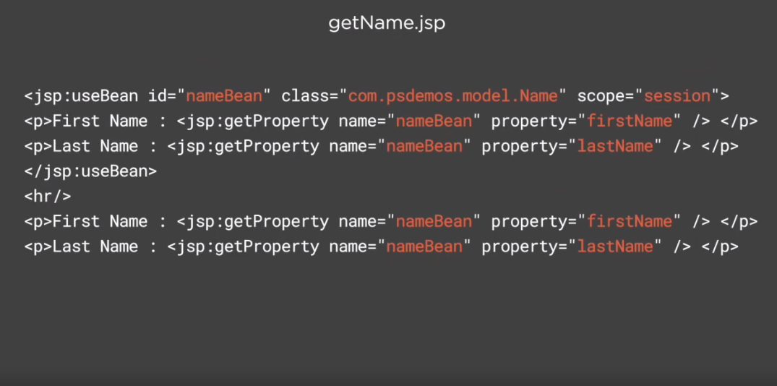

Slide 49
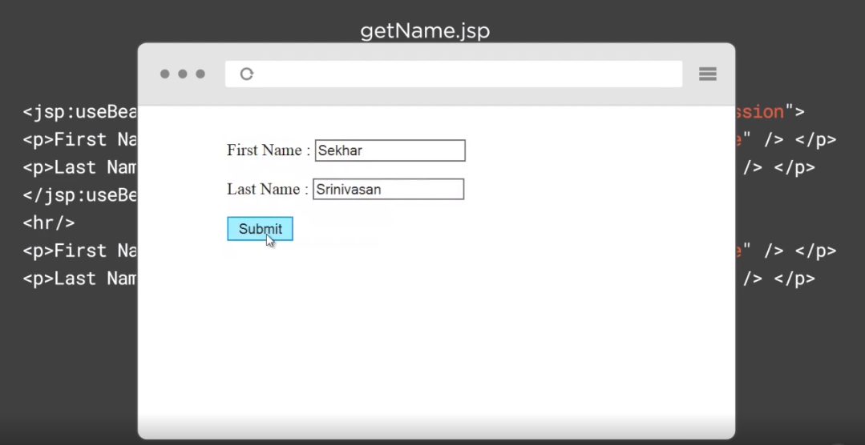

Slide 50
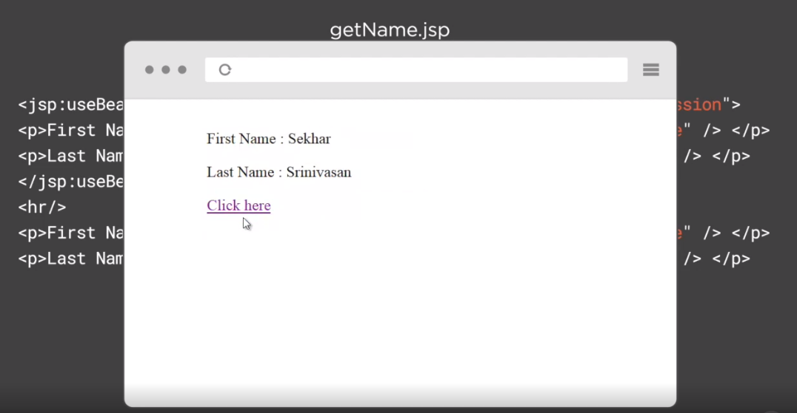

Slide 51
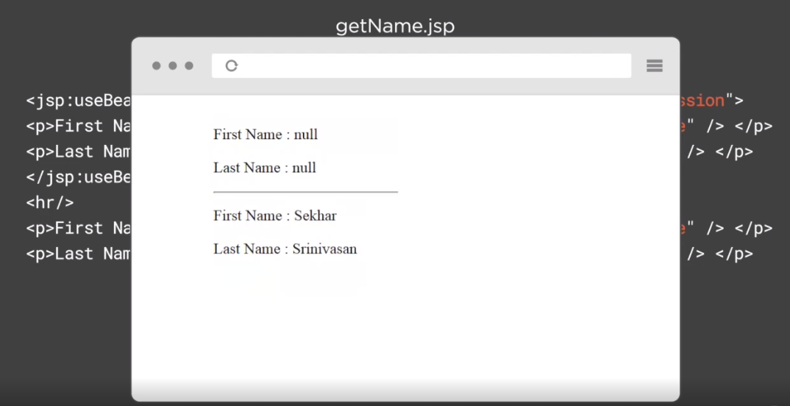

Slide 52
<jsp:plugins> and <jsp:fallback>

Slide 53
<jsp:plugin type="bean | applet " code="..."codebase="...">
<jsp:params>
<jsp:param name="..." value="...">
</jsp:params>
</jsp:plugin>
Syntax
<jsp:plugin>
Optional attributes type,align,height,width,name,title

Slide 54
<jsp:plugins> and <jsp:fallback>

Slide 55
<jsp:fallback>
used to provide some meaning information to the client's browser if the requested plugin cannot be started

Slide 56
<jsp:plugin type ="bean | applet" code="..."codebase="...">
<jsp:fallback>
<p> Error while loading the applet</p>
</jsp:fallback>
</jsp:plugin>
Syntax
<jsp:fallback>

Slide 59
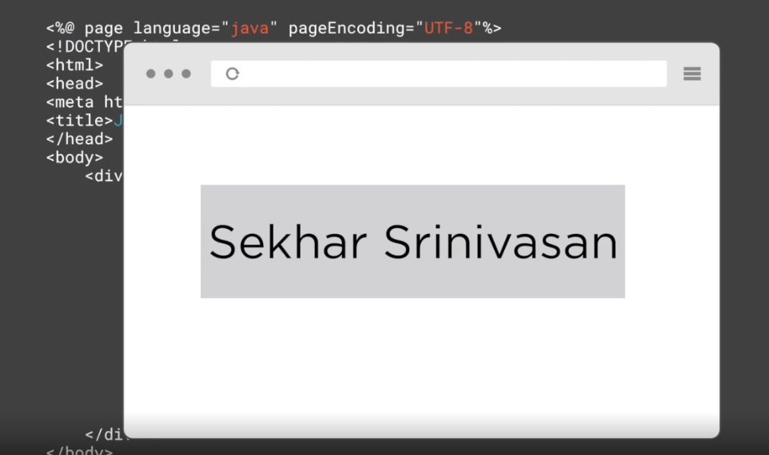

Slide 60
<jsp:element>,<jsp:attribute> and
<jsp:body>

Slide 61
Element Action
Without a body
With a body

Slide 62
<jsp:element name="elementName"/>
Syntax
<jsp:element> without a body

Slide 63
<jsp:element name="elementName">
<jsp:attribute>...</jsp:attribute>
<jsp:body>...</jsp:body>
</jsp:element>
Syntax
<jsp:element> witha body

Slide 65
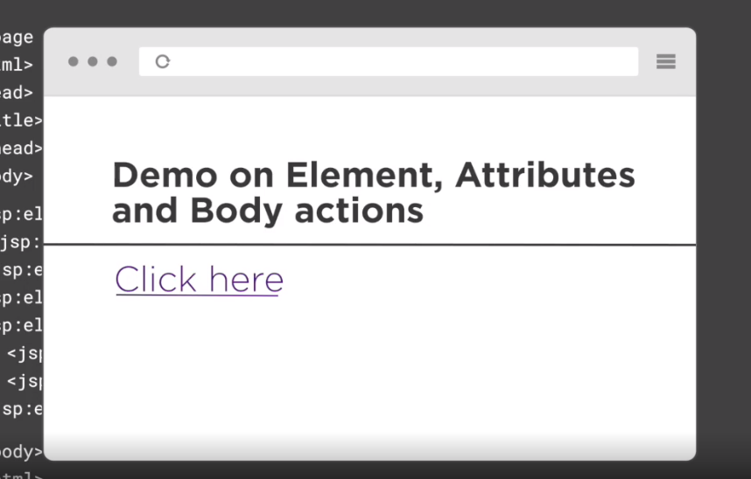

Slide 66
Assisted Practice
Working with Standard Actions

Slide 68

<jsp:include>
<jsp:forward>
<jsp:param>
<jsp:useBean>
<jsp:setProperty>
<jsp:getProperty>
<jsp:plugins>
<jsp:fallback>
<jsp:attribute>
<jsp:body>
<jsp:invoke>
<jsp:element>
<jsp:text>
Summary

